Slide 1
Introduction to Convolutional Neural Networks with Tensorflow
Week 10, Day 3

Slide 2

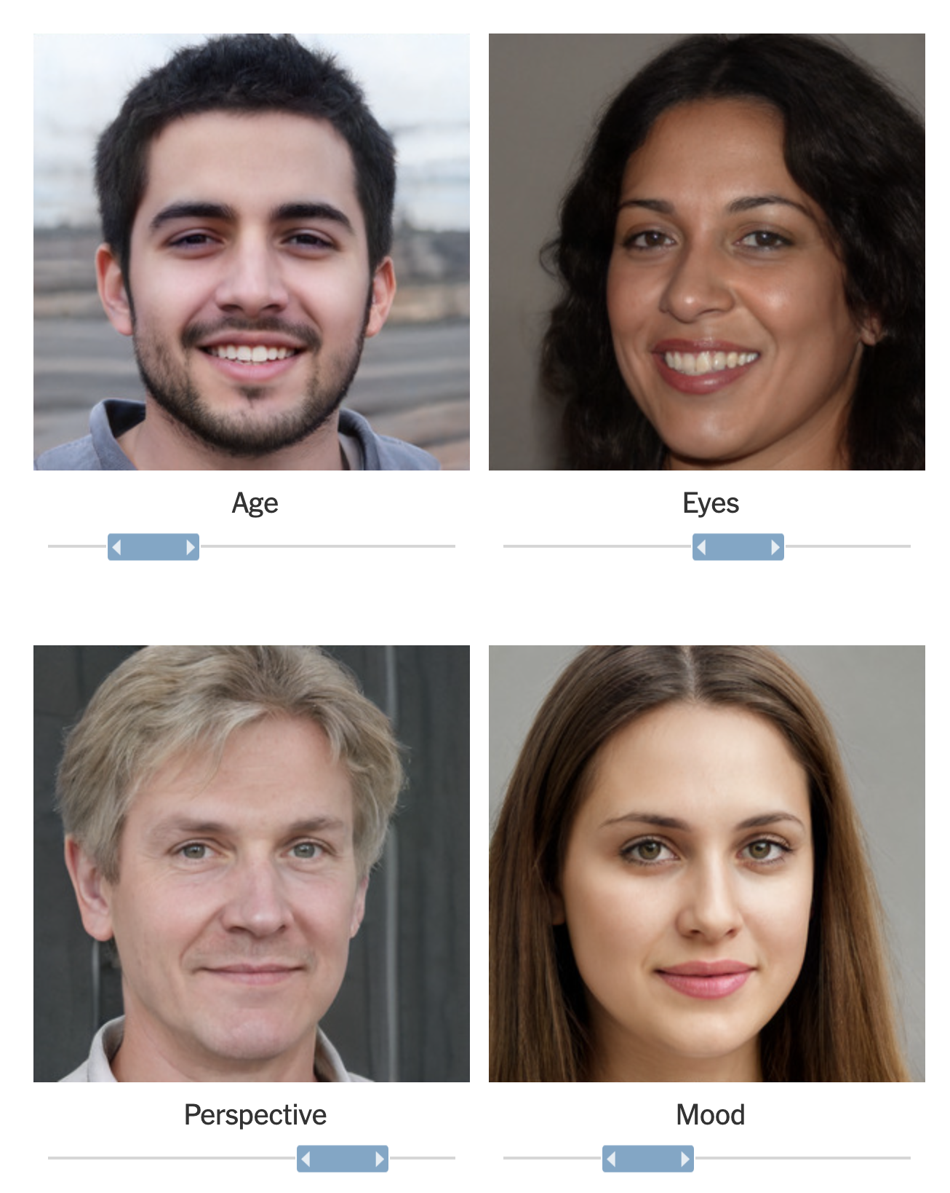
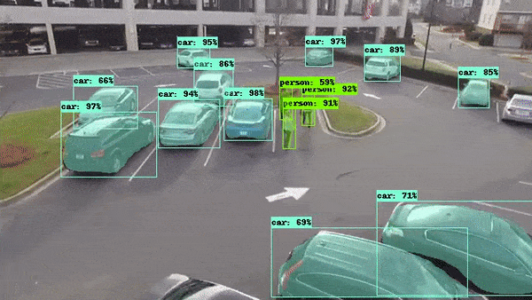
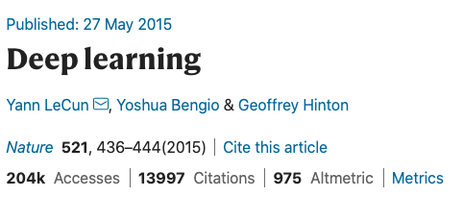
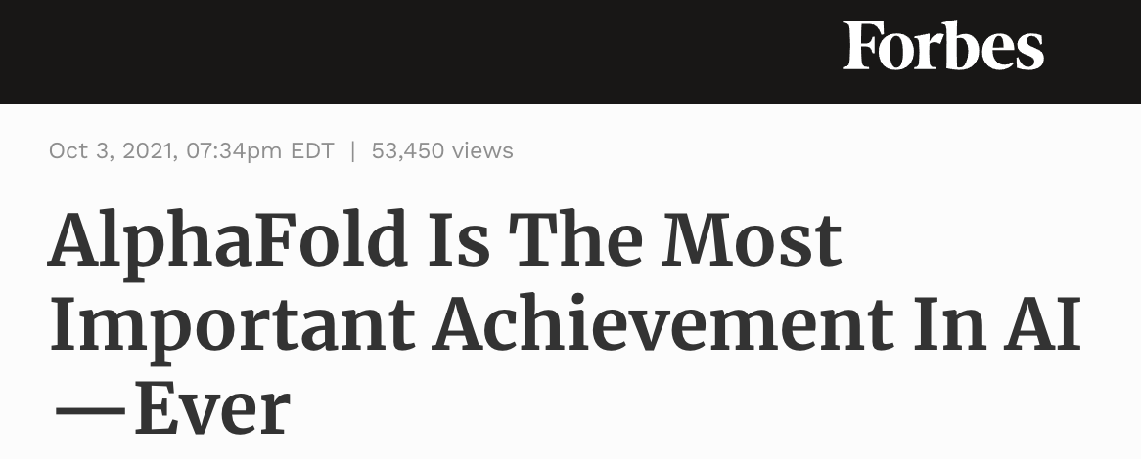
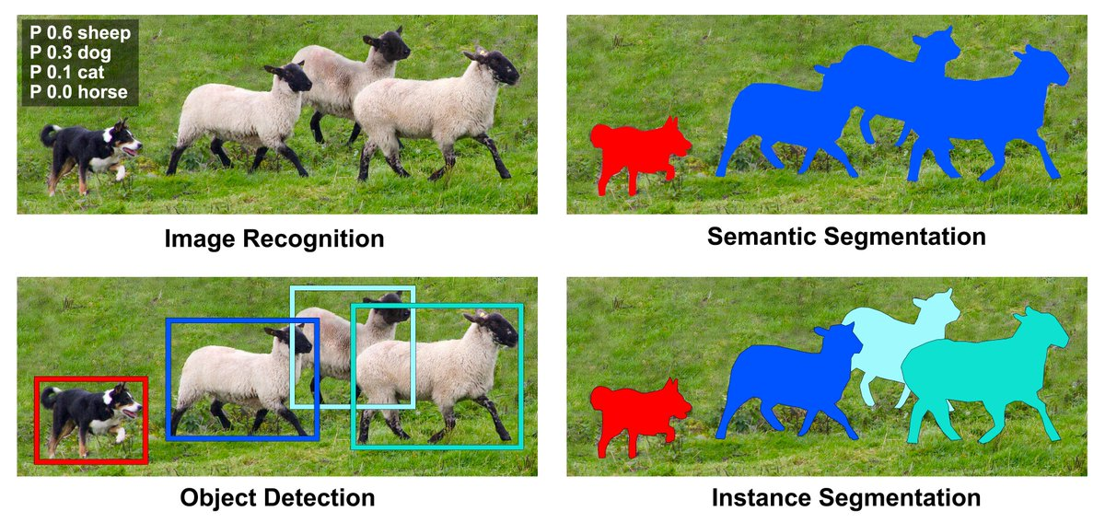

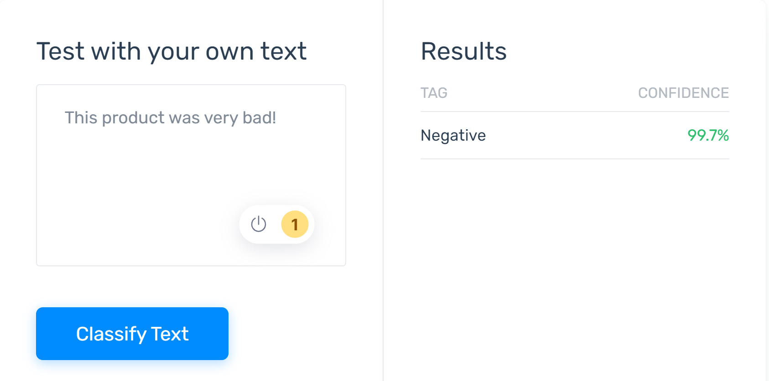

Deepfake Generation: Forbes Article
https://www.forbes.com/sites/robtoews/2021/10/03/alphafold-is-the-most-important-achievement-in-ai-ever/
37% of tech organizations use AI!
Sentiment Analysis of reviews.

Slide 3
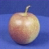
The machine learning framework
y = h(x)
Training: given a training set of labeled examples {(x₁,y₁), …, (x_{N},y_{N})}, estimate the prediction function h by minimizing the prediction error on the training set
Testing: apply h to a never before seen test example x and output the predicted value y = h(x)
h(. ) = “apple”
output
prediction function
Image feature

Slide 4
Deep Learning Pipeline
Step 1
Step 2
Step 3
Step 4
Step 5
Load and Preprocess Data
Data Visualization
Design the Deep Learning Model
Train the Model
Define
Evaluate the Model

Slide 5
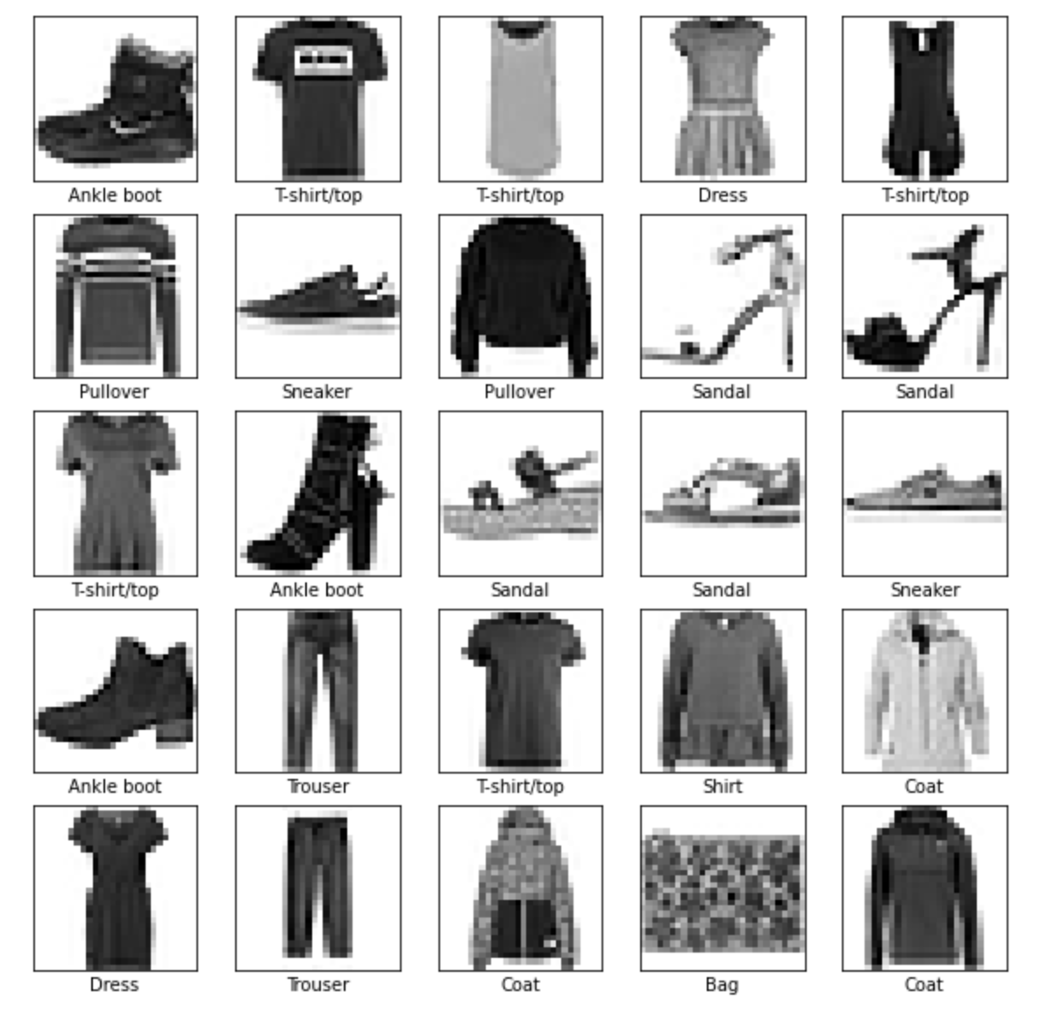
Agenda
For this exercise, we will use Fashion MNIST dataset to classify the clothing in an image. We will follow the 6-step pipeline to design our convolutional neural network.

Slide 6
Step 1: Load and Preprocess the Data
Task 1: Download/fetch the dataset.
Task 2: Split the dataset to training and testing datasets.
Task 3: Normalize and preprocess the datasets.
# task 1: download/fetch the dataset
fashion_mnist = tf.keras.datasets.fashion_mnist
# task 2: split the dataset to training and testing datasets (train_images, train_labels), (test_images, test_labels) = fashion_mnist.load_data()
# task 3: normalize and preprocess the datasets.
train_images = train_images / 255.0 test_images = test_images / 255.0
train_images = train_images.reshape(-1, 28, 28, 1)
test_images = test_images.reshape(-1, 28, 28, 1)

Slide 7
Step 1, Task 2: Training and Testing Data Splits for Generalization of the Model
Training Labels
How well does a learned model generalize from the data it was trained on to a new test set?
Generalization refers to your model's ability to make correct predictions on new, previously unseen data as opposed to the data used to train the model.
Training Data
h
Training
Learned model
Testing Data
h
Learned model
Prediction

Slide 8
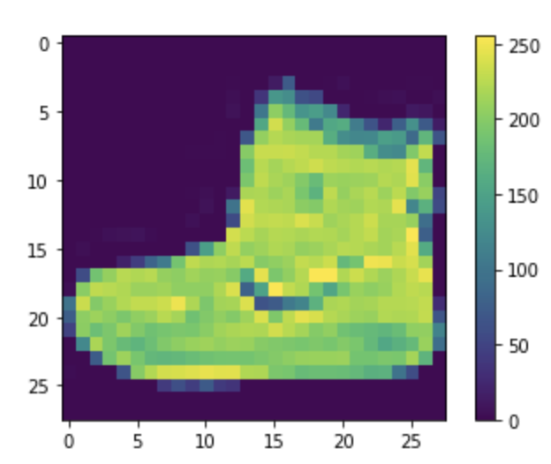
Step 2: Data Visualization
It is important to visualize some samples from the dataset. This allows us to verify the data as well as visually inspect the differences between different classes in the dataset.
plt.figure() plt.imshow(train_images[0]) plt.colorbar() plt.grid(False) plt.show()

Slide 9
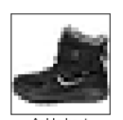
Step 3: Design the Deep Learning Model
Deep Learning Super Resolution
model = tf.keras.Sequential([
# Conv 2D, MaxPool, with optional Dropout
tf.keras.layers.Conv2D(filters=64, kernel_size=2,
padding='same', activation='relu’, input_shape=(28,28,1)),
tf.keras.layers.AveragePooling2D(pool_size=2),
tf.keras.layers.Dropout(0.3),
# Conv 2D, MaxPool, with optional Dropout
tf.keras.layers.Conv2D(filters=32, kernel_size=2,
padding='same', activation='relu'),
tf.keras.layers.MaxPooling2D(pool_size=2),
tf.keras.layers.Dropout(0.3),
# Flatten the layer to feed to Dense layer
tf.keras.layers.Flatten(),
# Final Dense layers for classification
tf.keras.layers.Dense(256, activation='relu'),
tf.keras.layers.Dropout(0.5),
# Converting to probability domain using Softmax
tf.keras.layers.Dense(10, activation='softmax')
])
Feature Extractors
Convolution 2D (edges, contrast)
MaxPooling
Convolution 2D (objects)
MaxPooling
Hidden Layer
Softmax
28
Ankle Boot
28
10
Low-level
256
Mid-level or high-level

Slide 10
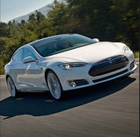

Feature extractor
Fully Connected Feedforward network
Convolution
Max Pooling
Convolution
Max Pooling
car
Flattened
Edges, contrast
Alphabets and color
A new image
A new image

Slide 11
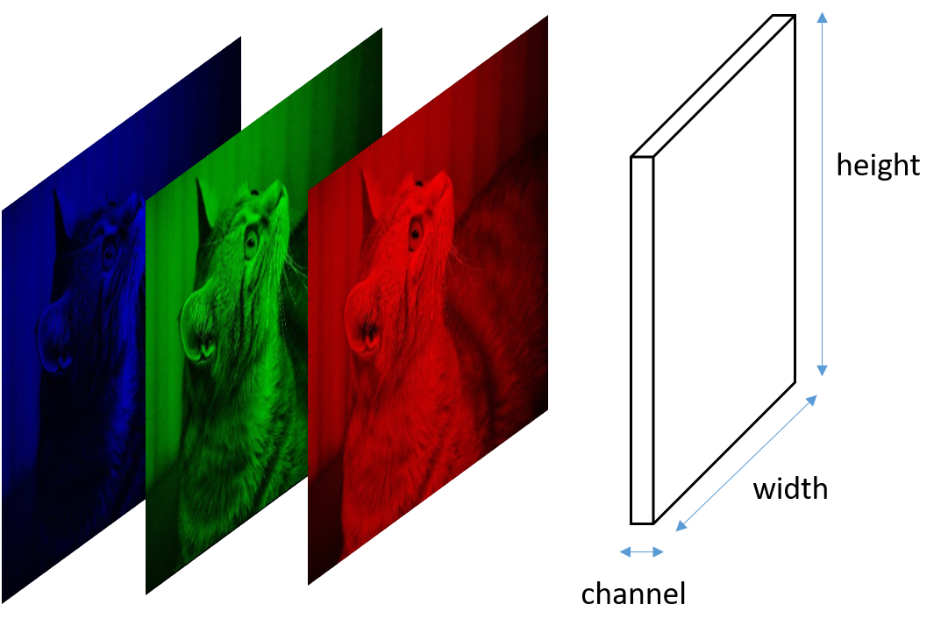
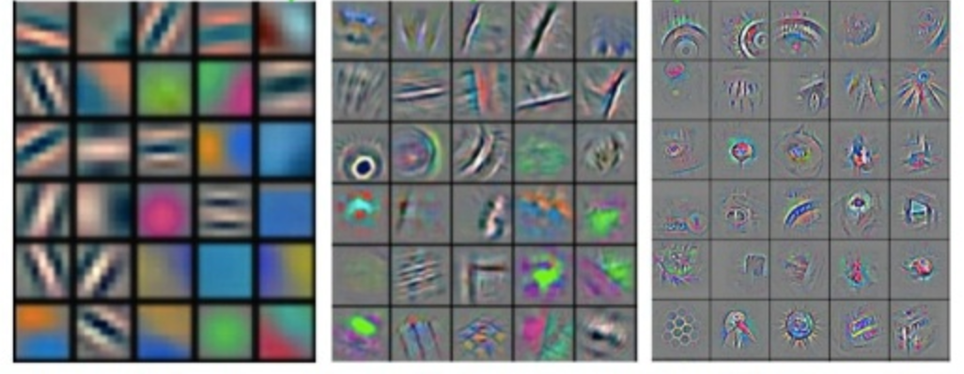

Conv Layer 1
Conv Layer 2
Conv Layer 3
CAT
Low-level features
Mid-level features
High-level features
Edges, contrast, colors,
and color-gradients
Shapes of objects
and colors
The objects and
some colors
https://www.analyticsvidhya.com/blog/2021/05/20-questions-to-test-your-skills-on-cnn-convolutional-neural-networks/

Slide 12
Problems with fully connected NW
256*256 = 1x65536 vector
Huge amount of compute (GPUs).
We need a large network.
It automatically increases the amount of compute required
Extremely large number of parameters.
reduction
256
NN
10 outputs
256
65k -> 40k -> 20k -> 10k -> …

Slide 13
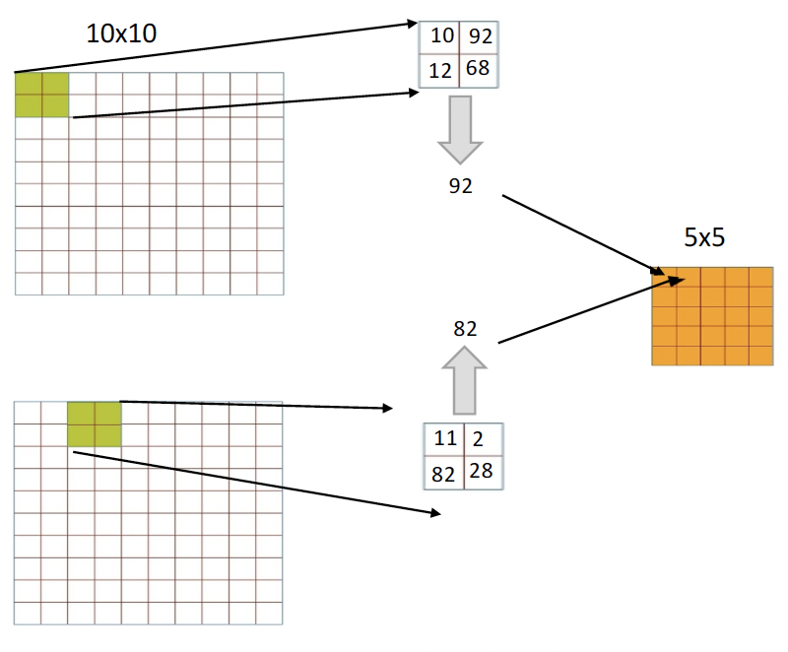
Pooling
Pooling operation reduces the dimensionality of each feature map by retaining the most important information present in them. There are different types of Pooling operation available, including Max Pooling, Average Pooling, etc. It is applied after convolution and RELU operations. By doing so, we reduce the size of the output feature maps considerably, thereby reducing the computational requirements for training the CNNs.
Example of Max Pooling.

Slide 14
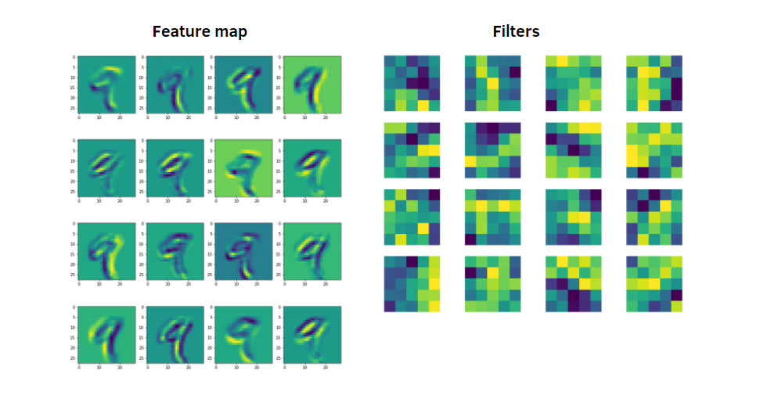
filters=16,
kernel_size=5

Slide 15

filters=8,
kernel_size=3
filters=4,
kernel_size=4
FCN
Input image
Feature maps
8 of them
Size of feature map -> parameters we set for the kernel

Slide 16
Step 4: Train the Deep Learning Model
model.compile(optimizer='adam’,
loss=tf.keras.losses.SparseCategoricalCrossentropy(from_logits=False),
metrics=['accuracy’])
model.fit(train_images, train_labels, epochs=10)

Slide 17
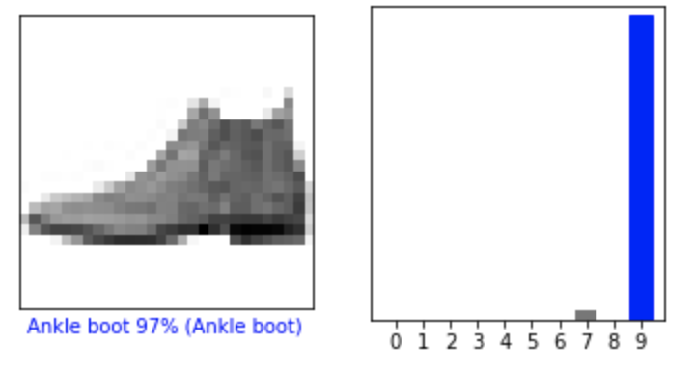
Step 5: Evaluate the Model
test_loss, test_acc = model.evaluate(test_images, test_labels, verbose=2)
print('\nTest accuracy:', test_acc)
i = 0
plt.figure(figsize=(6,3))
plt.subplot(1,2,1)
plot_image(i, predictions[i], test_labels, test_images.reshape(-1, 28,28))
plt.subplot(1,2,2)
plot_value_array(i, predictions[i], test_labels)
plt.show()

Slide 18
New Model Architectures (Steps 3,4 & 5)
model = tf.keras.Sequential([
# Conv 2D, MaxPool, with optional Dropout
tf.keras.layers.Conv2D(filters=64, kernel_size=2,
padding='same', activation='relu', input_shape=(28,28,1)),
tf.keras.layers.MaxPooling2D(pool_size=2),
tf.keras.layers.Dropout(0.3),
# Conv 2D, MaxPool, with optional Dropout
tf.keras.layers.Conv2D(filters=32, kernel_size=2,
padding='same', activation='relu'),
tf.keras.layers.MaxPooling2D(pool_size=2),
tf.keras.layers.Dropout(0.3),
# Conv 2D, MaxPool, with optional Dropout
tf.keras.layers.Conv2D(filters=..., kernel_size=...,
padding='same', activation='relu'),
tf.keras.layers.MaxPooling2D(pool_size=...),
tf.keras.layers.Dropout(...),
# Conv 2D, MaxPool, with optional Dropout
tf.keras.layers.Conv2D(filters=..., kernel_size=...,
padding='same', activation='relu'),
tf.keras.layers.MaxPooling2D(pool_size=...),
tf.keras.layers.Dropout(...),
# Flatten the layer to feed to Dense layer
tf.keras.layers.Flatten(),
# Final Dense layers for classification
tf.keras.layers.Dense(256, activation='relu’),
tf.keras.layers.Dense(128, activation='relu'),
tf.keras.layers.Dropout(0.5),
# Converting to probability domain using Softmax
tf.keras.layers.Dense(10, activation='softmax')
])
Convolution 2D
MaxPooling
Convolution 2D
MaxPooling
Convolution 2D
MaxPooling
Hidden Layer
Softmax
28
Ankle Boot
28
10
256

Slide 19
Terminology
https://developers.google.com/machine-learning/glossary
Batch | The set of examples used in one iteration (that is, one gradient update) of model training.
Batch size | The number of examples in each batch.
Epoch | The number of times we cover the entire dataset during training. Steps in each epoch = Total samples / batch size.
Activation function | A function (for example, ReLU or sigmoid) that takes in the weighted sum of all of the inputs from the previous layer and then generates and passes an output value (typically nonlinear) to the next layer.
Iteration | A single update of a model's weights during training. An iteration consists of computing the gradients of the parameters with respect to the loss on a single batch of data.
Dense or Fully Connected Layer | A hidden layer in which each node is connected to every node in the subsequent hidden layer.
Generalization | Refers to your model's ability to make correct predictions on new, previously unseen data as opposed to the data used to train the model.
Hidden Layer | A synthetic layer in a neural network between the input layer (that is, the features) and the output layer (the prediction). Hidden layers typically contain an activation function (such as ReLU) for training.

Slide 20
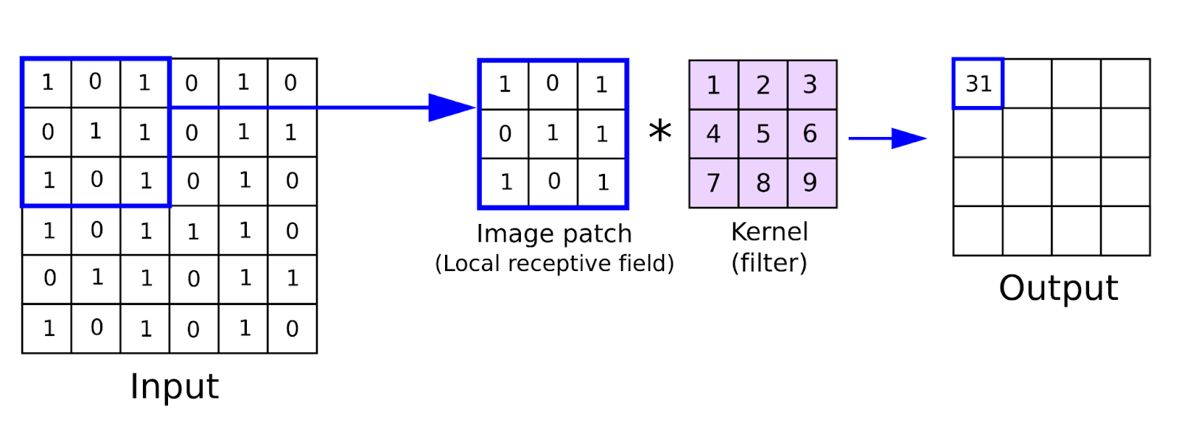
Details on Convolution Convolution Operation for Images
A
B
Elementwise
Multiply and Add
np.dot(A,B)
(height, width, channels)
Feature map
Kernel = [[1,0,1],
[0,1,0],
[1,0,1]]
tf.keras.layers.Conv2D(filters=1, kernel_size=(4,2),
padding='same', activation='relu’, input_shape=(5,5,1)),
An image patch is extracted, and a kernel is convolved with the image patch. Once the convolution operation is finished in the first patch, we shift the patch forward, and continue with the convolution operation. Resulting output are the convolved features, which gets passed as inputs to the next convolution layer. This allows for parameter sharing, where we don’t have to connect each input neuron from the previous layer to the next layer like we did for FCN. Now, we can learn good kernels to extract good information from an image patch.

Slide 21


Input to Conv Layer
Kernel of Conv Layer
Output of Conv Layer
Feature Map
2
Done
*1 | *2
*3 | *4
*5 | *6
*7 | *8
4
*1 | *2
*3 | *4
*5 | *6
*7 | *8
5
“Knobs”
2
4
5
tf.keras.layers.Conv2D(filters=2, kernel_size=(4,2),
padding='same', activation='relu’, input_shape=(5,5,1)),
*1 | *2
*3 | *4
*5 | *6
*7 | *8
*1 | *2
*3 | *4
*5 | *6
*7 | *8
tf.keras.layers.Conv2D(filters=2, kernel_size=2,
padding='same', activation='relu’)

Slide 22


KERNEL
KERNEL
KERNEL
KERNEL
64

